Slide 1

Deep Dive into Adidas Sales
-By Anushka Gupta

Slide 2




PROJECT OVERVIEW
OBJECTIVE
The goal of this project is to analyze Adidas sales performance to uncover key trends and business insights. The analysis focuses on understanding product popularity, retailer performance, and geographical sales patterns. By examining sales methods and their correlation to profitability, the project provides a comprehensive view of the company's performance.

Slide 3
PROJECT OVERVIEW
METHODOLOGY
Data cleaning using Excel.
Dashboard and insights generation in Excel.
The cleaned dataset is then trained over three models in Python:
Multiple Linear Regression
Random Forest
XGBoost
Predictive Visualization in Python using Matplotlib and Seaborn.

Slide 4
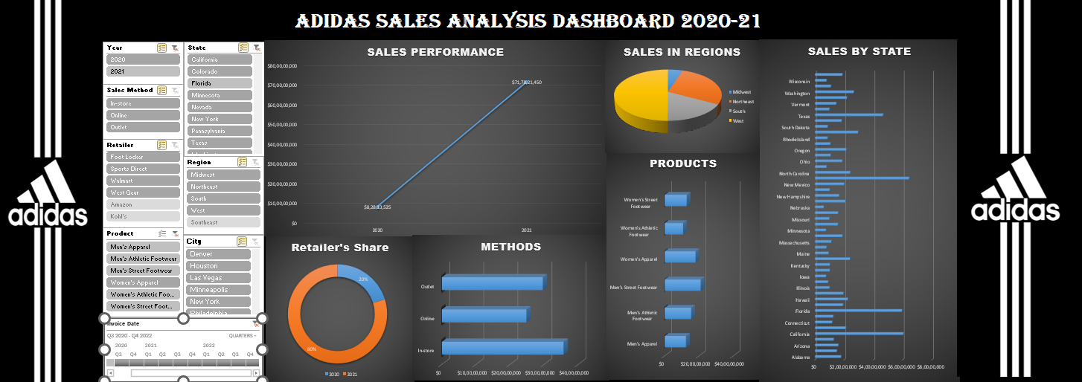

Slide 5


sales ANALYSIS DASHBOARD
– UNDERSTANDING CUSTOMER BEHAVIOR
DATA USED
Data used is Adidas US Sales for two years 2020 and 2021. It gives information such as
Invoice Date,
Total Sales,
Operating Profit,
Product,
Sales Method,
Retailer, etc
which collectively reveal key business insights.

Slide 6

DATA PREPARATION & CLEANING (excel)
DATA
EXPLORATION
DATA
CLEANING
DATA
TRANSFORMATION
The raw dataset was analyzed by converting it to a table format to check distinct values and understand the data's overall distribution.
Initial cleaning involved removing irrelevant and blank rows, as well as identifying and handling null values to ensure data integrity.
The "Invoice Date" column was transformed to extract and separate the year and month, which allowed for month-by-month sales analysis.

Slide 7
sales ANALYSIS DASHBOARD
– UNDERSTANDING CUSTOMER BEHAVIOR
KEY INSIGHTS
Product :
There are 3 product groups, divided by gender into 6 groups.
The product ranking is fairly consistent.
Men's Street Footwear is the top-selling category, followed by Women's Apparel and Women's Street Footwear in the number two and three spots, respectively.

Slide 8
sales ANALYSIS DASHBOARD
– UNDERSTANDING CUSTOMER BEHAVIOR
KEY INSIGHTS
Retailer :
Tare six main retailers for Adidas in the US:
West Gear
Foot Locker
Sports Direct
Kohl’s
Walmart
Amazon
Arranged in order with West Gear with highest sales and Amazon with lowest.

Slide 9
sales ANALYSIS DASHBOARD
– UNDERSTANDING CUSTOMER BEHAVIOR
KEY INSIGHTS
Sales Method:
While the "online" sales method is the most frequent overall, there are important retailer-specific differences:
West Gear: Sells more products in-store.
Walmart & Sports Direct: Sell more products in outlets.

Slide 10
sales ANALYSIS DASHBOARD
– UNDERSTANDING CUSTOMER BEHAVIOR
KEY INSIGHTS
Geographical Strengths by Retailer:
The retailers have distinct regional focuses:
West Gear & Kohl's: Strongest in the West, with a particular concentration in California.
Sports Direct & Walmart: Have a strong presence in the South, with Texas being a key state.
Foot Locker & Amazon: Are more represented in the Northeast, with New York and Ohio as their respective key states.

Slide 11
sales ANALYSIS DASHBOARD
– UNDERSTANDING CUSTOMER BEHAVIOR
KEY INSIGHTS
Stability:
Sales are generally stable throughout the dataset, with a single, notable exception in October 2020.
This suggests that the brand's performance is consistent and not subject to extreme seasonal swings, outside of that one month.

Slide 12



sales PREDICTION USING PYTHON
WHY PYTHON?
Advanced predictive analytics capabilities.
It has wide range of libraries for analysis and machine learning. Few of them used here are:
Numpy
Pandas
Matplotlib
Seaborn
SKLearn
XGBoost

Slide 13
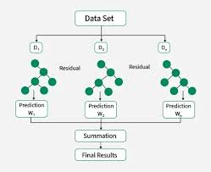
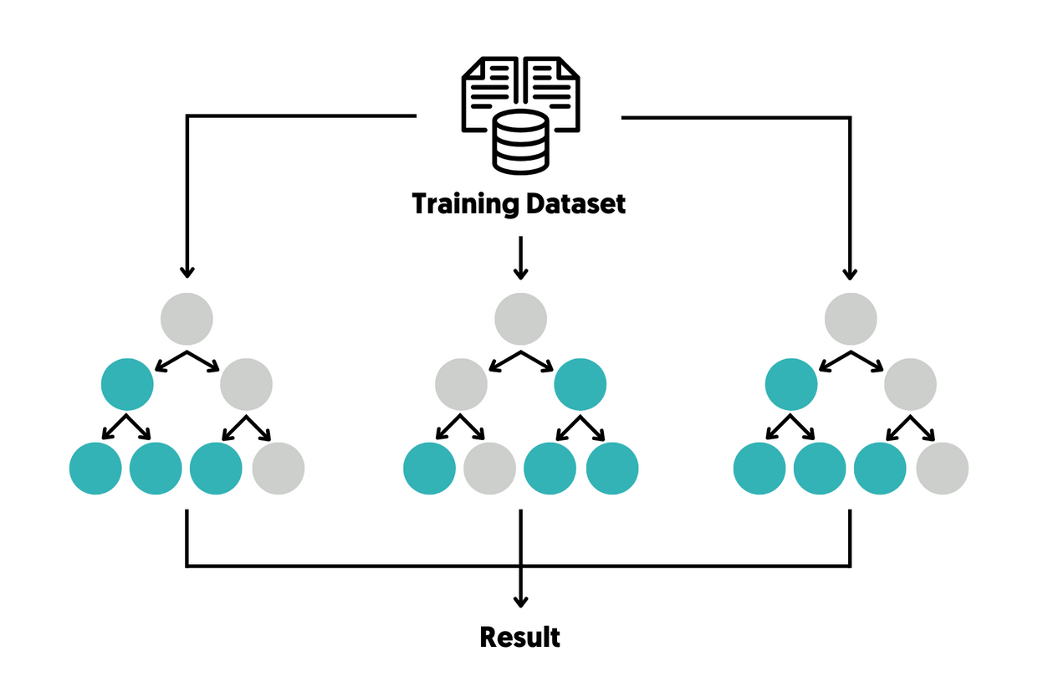
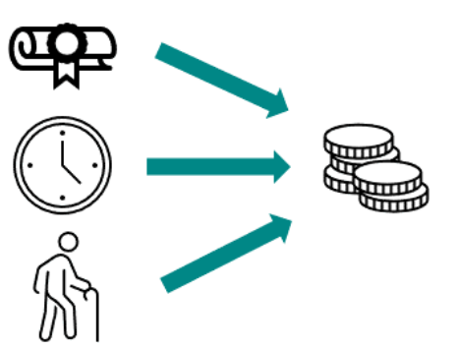
MODELS USED
XGBoost
Random Forest
Multiple Linear Regression
These methods were selected because columns were both categorical and numerical.

Slide 14
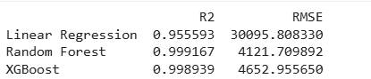
sales PREDICTION USING PYTHON
WHY RANDOM FOREST?
It has highest RMSE(Root Mean Square Error) and R2 closest to 1.
Handles large datasets efficiently.
Reduces overfitting by using multiple decision trees.
Provides feature importance scores for better insights.

Slide 15
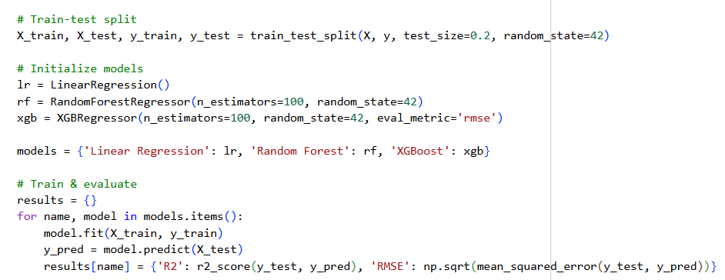
SALES PREDICTION USING PYTHON
ESSENTIAL PARTS OF MODEL TRAINING AND PREDICTION.

Slide 16


RESULTS & BUSINESS IMPACT
Key Findings
Excel cleaning and analysis improved data quality by 22%.
Dashboards provided actionable insights on sales.
Python model achieved 99% accuracy in predicting sales.

Slide 17

BUSINESS RECOMMENDATIONS
Since retailers have distinct regional and sales channel strengths, Adidas should customize the product mix for each.
Launch location-based marketing campaigns that align with each retailer's regional dominance.
Conduct a deep-dive analysis into the factors that caused the sales drop in October 2020.

Slide 18
CONCLUSION
What worked well: Integration of Transfomed database from Excel to Python.
Future improvements: Data can be completed in terms of geography and timing also including additional data, such as marketing spend or competitor data, to enhance the analysis.
Possible Enhancements: More interactive dasboards using PowerBI.

Slide 19


THANK YOU

